Slide 1
Factors Affecting Restaurants
Group 30 Chao Kaijie
Zhao Hongshan
Zhang Siwei

Slide 2
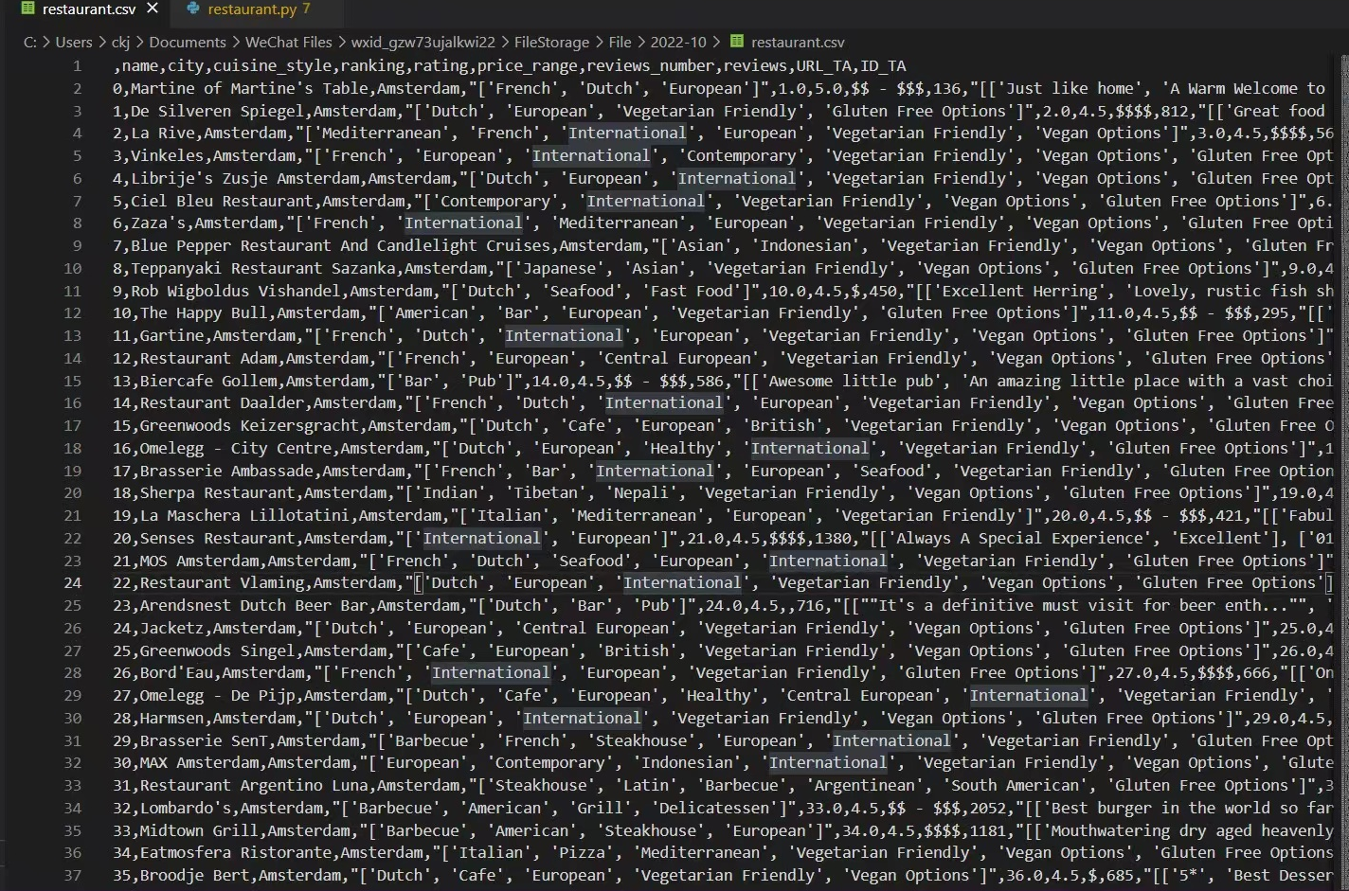
Dataset

Slide 3
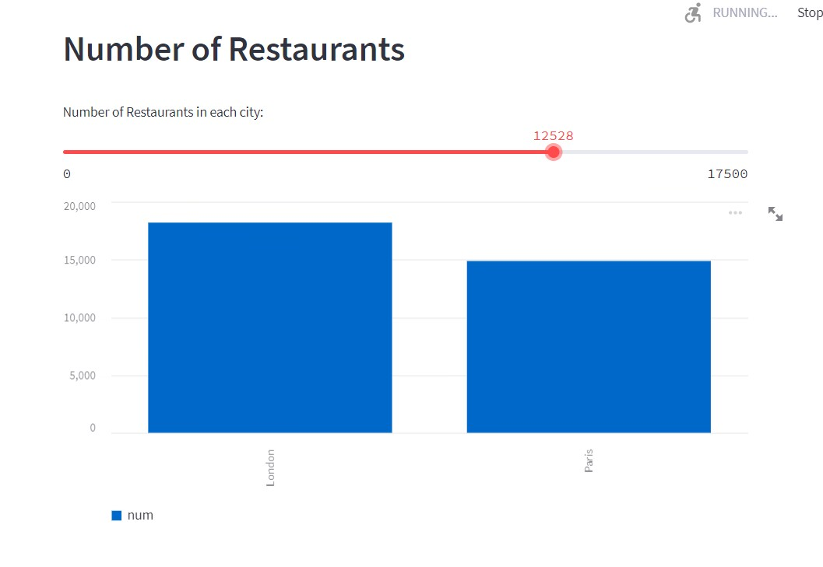
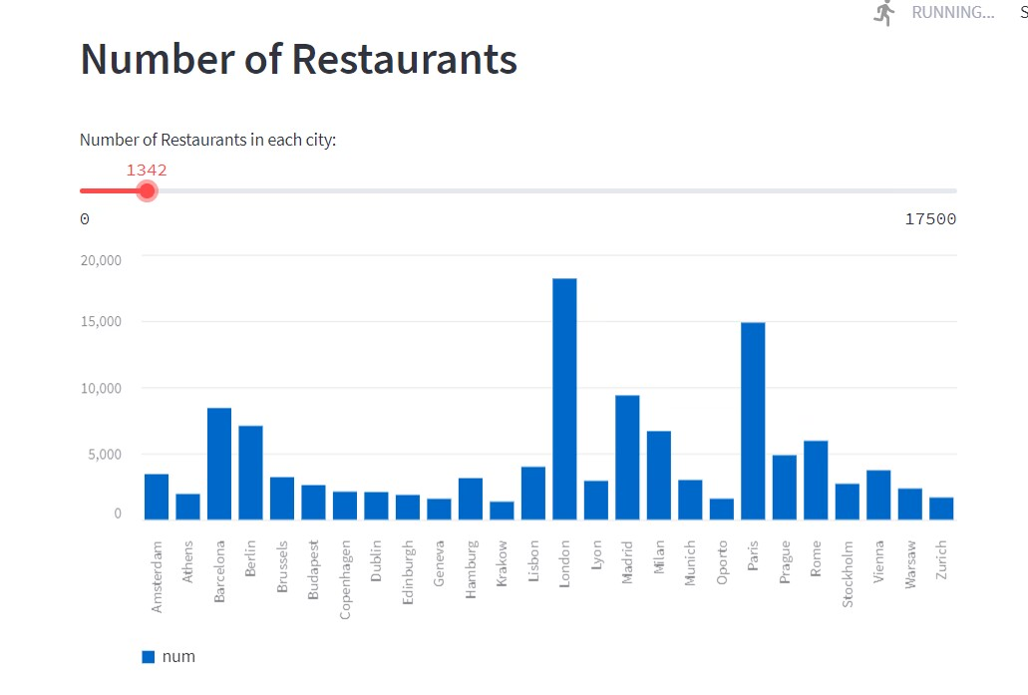
Numbers
Maybe, we can also know the prosperity and vitality of the city
“London” and “Paris” ------good examples
-We can drag the progress bar to change the number of restaurants in each city

Slide 4
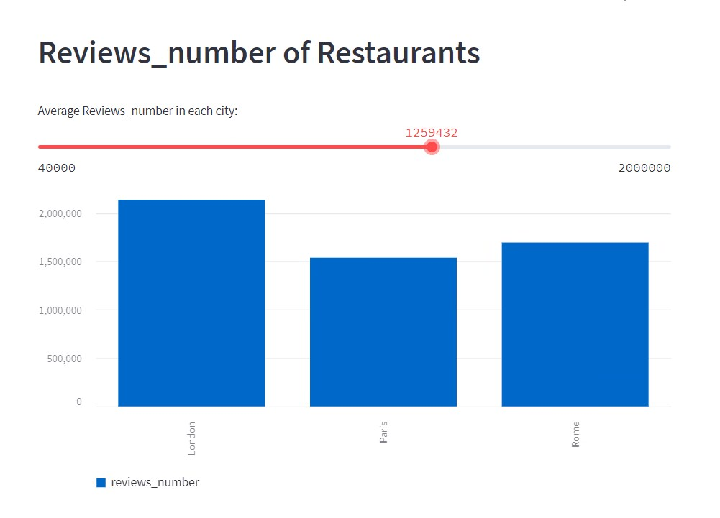
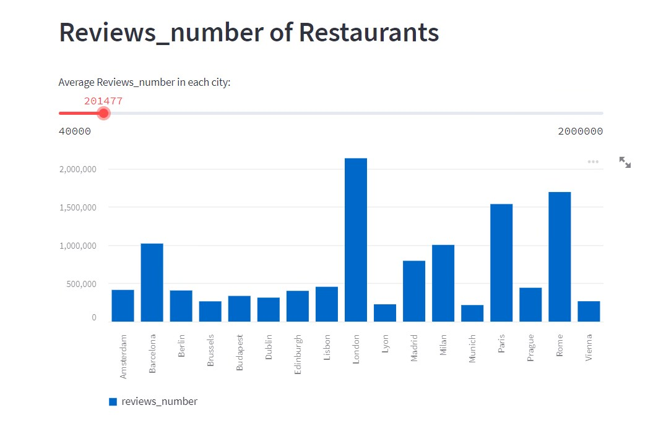
Reviews
The “review” chart is basically the same as the “number” chart.
Although they are generally the same, they are also special
“Roma”-----typical example

Slide 5
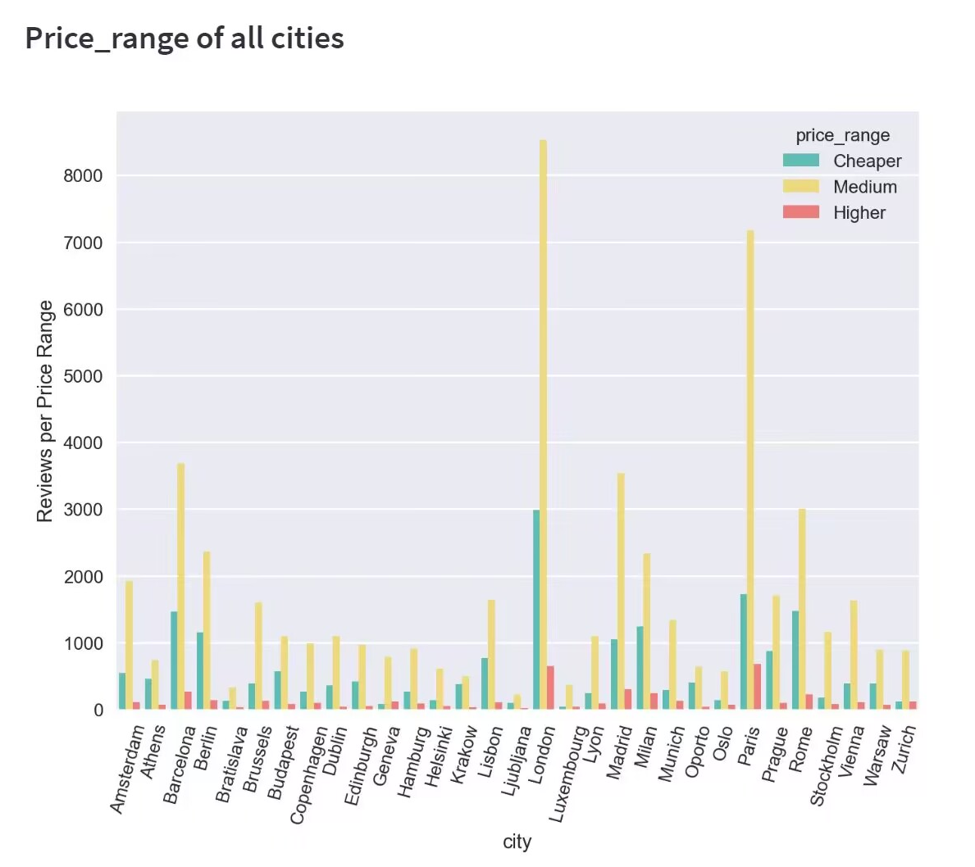
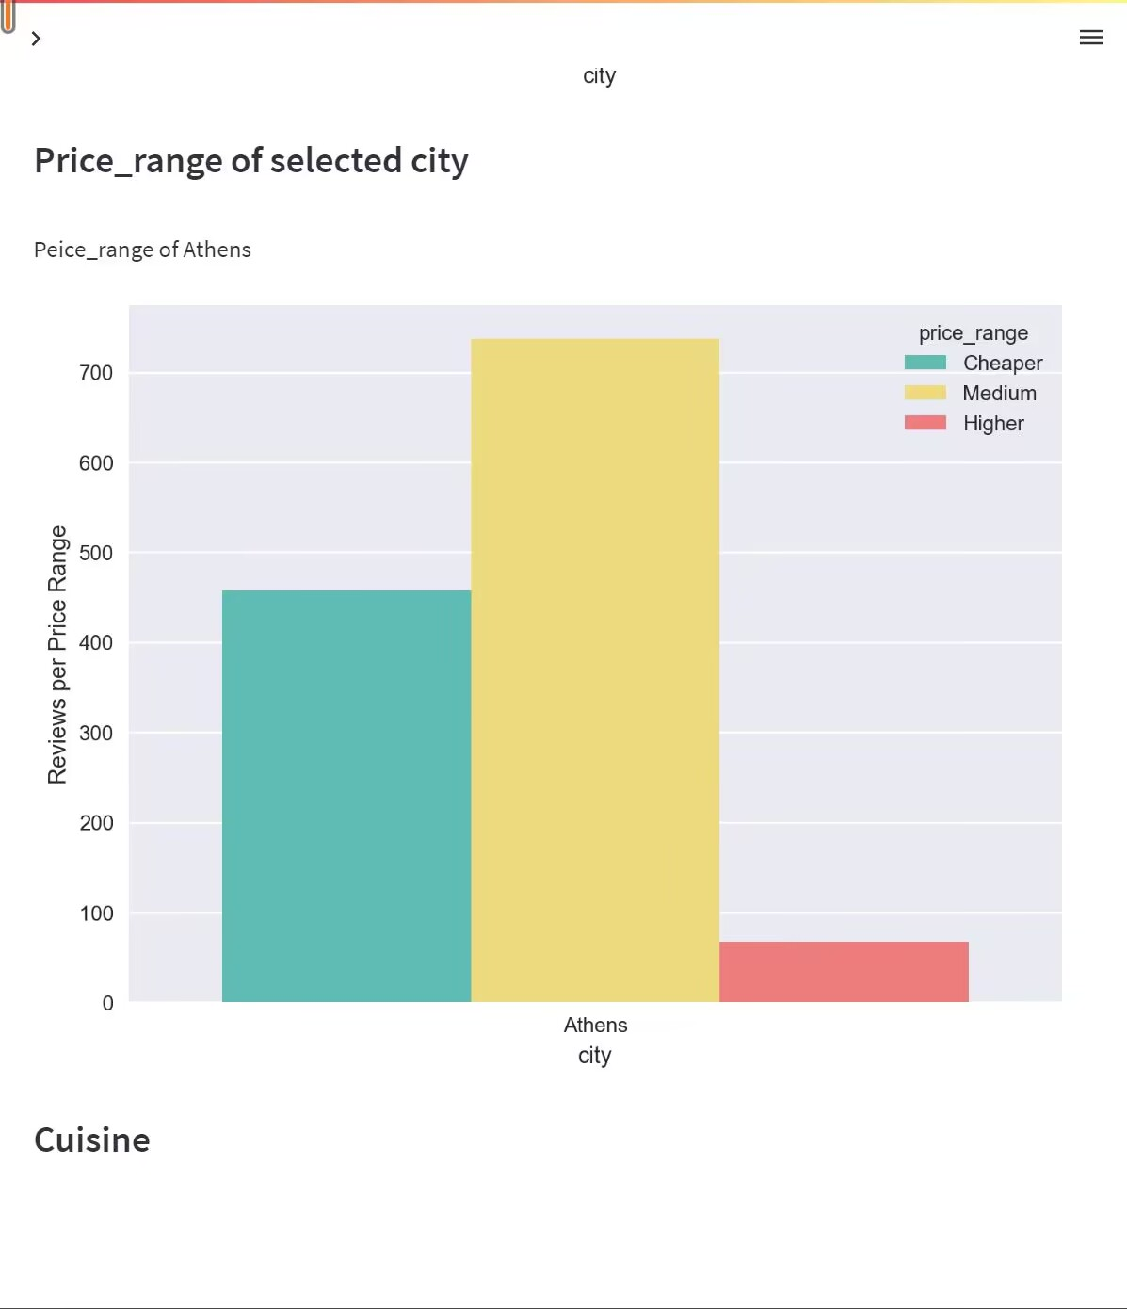
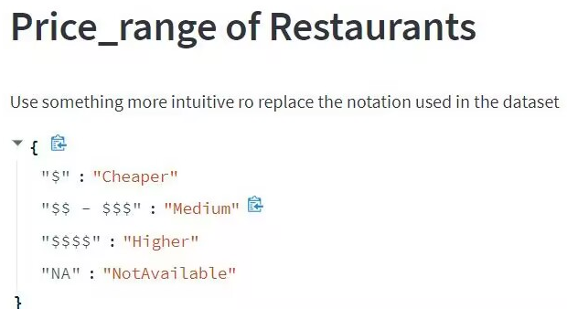
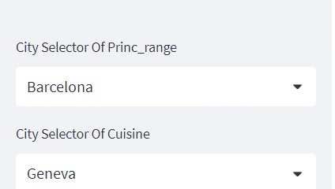
Price
Some general rules can be seen in the chart, with restaurants in any city being the most to be welcomed for medium prices
For ease of production and statistics, we used different combinations of the dollar sign 💲 to represent prices.
Even more conveniently, we can type the city directly into the search box to pinpoint the price range directly

Slide 6
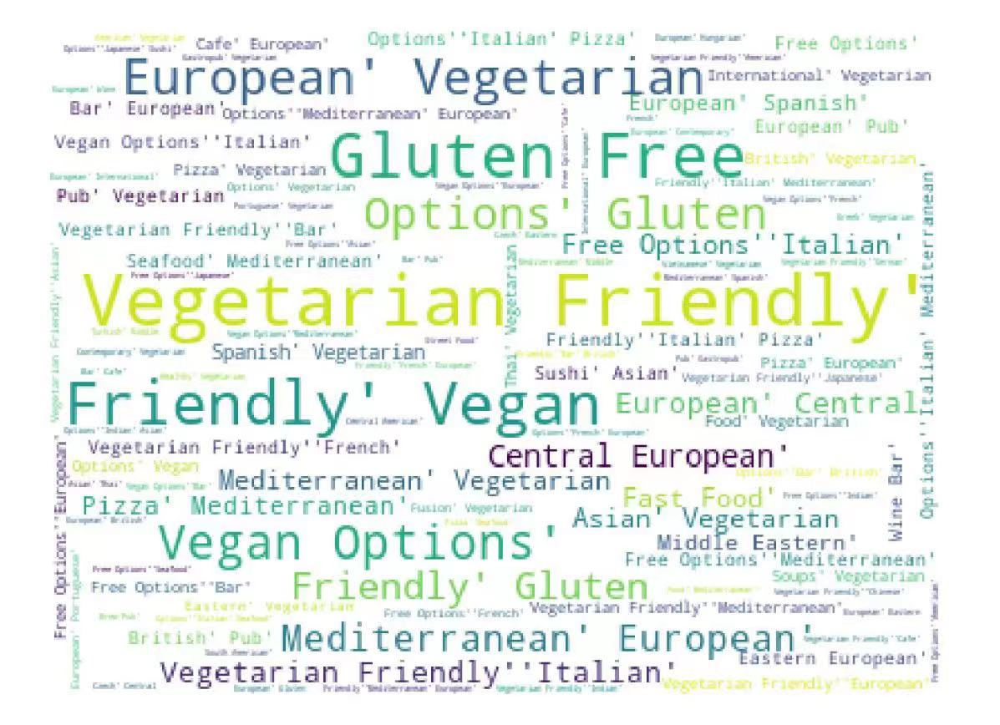
Cuisine
--We're still working on the impact of flavor on restaurants, but we're still working on that
←
effect picture

Slide 7
Group 30
Thanks!

